Slide 1
THEORY OF ORTHOGRAPHIC PROJECTION
PROJECTION
A method to describe shape by the process of causing an image to be formed by rays of sight taken in a particular direction from an object to a picture plane.
    If the rays are perpendicular to the picture plane, the projection is known as Orthographic Projection.
    If the rays are at an angle to the plane, the projection is known as Oblique Projection.
    If the rays are taken to a particular station point, the projection is know as Perspective Projection.

Slide 2
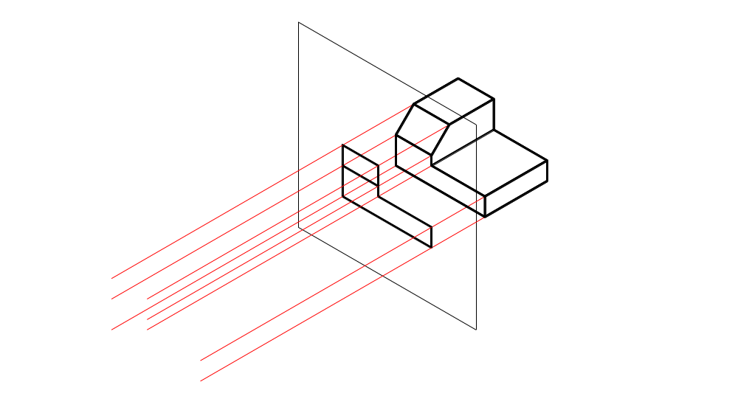
Orthographic Projection looking through the plane
(Plane between observer and object)

Slide 3
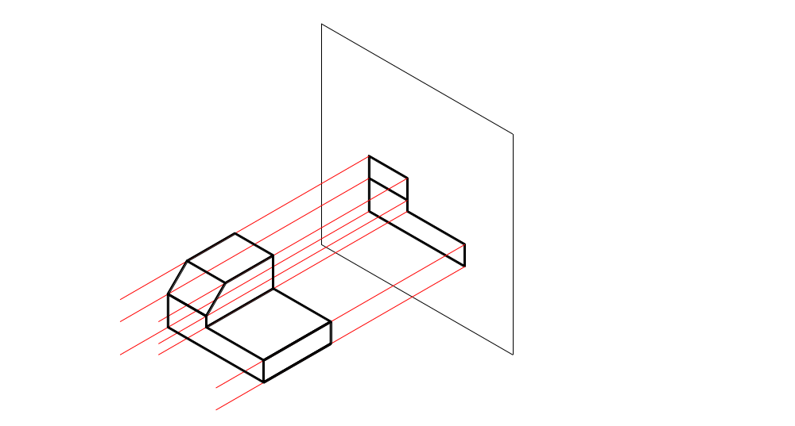
Orthographic Projection observing the object directly
(Object between Observer and Plane)

Slide 4
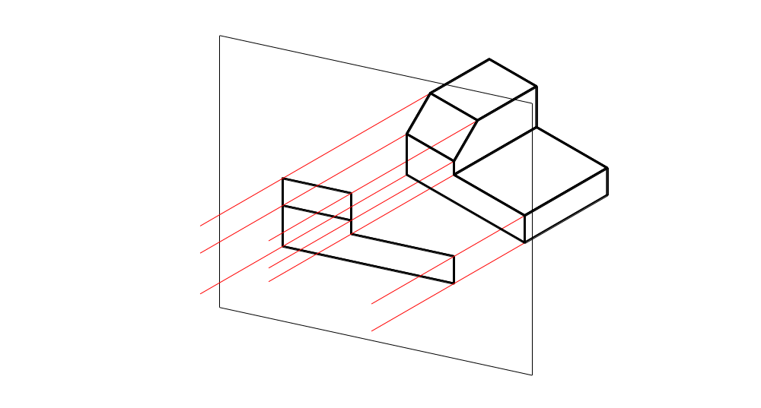
Oblique Projection Looking through the Plane
(Plane between Observer and Object)

Slide 5
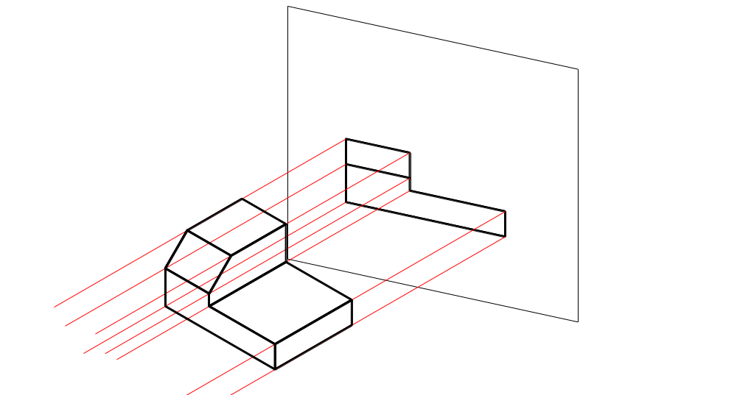
Orthographic Projection observing the object directly
(Object between Observer and Plane)

Slide 6
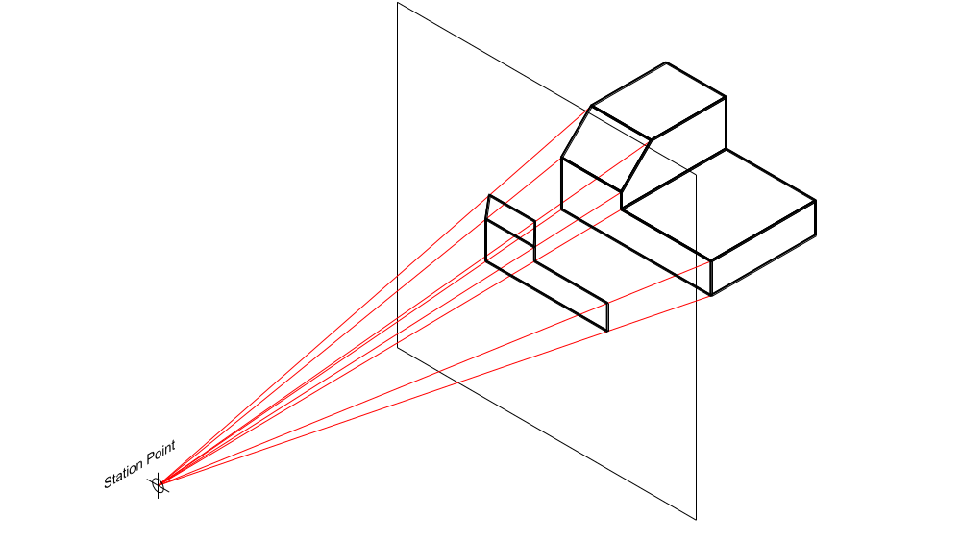
Perspective Projection looking through the plane
(Plane between observer and object)

Slide 7
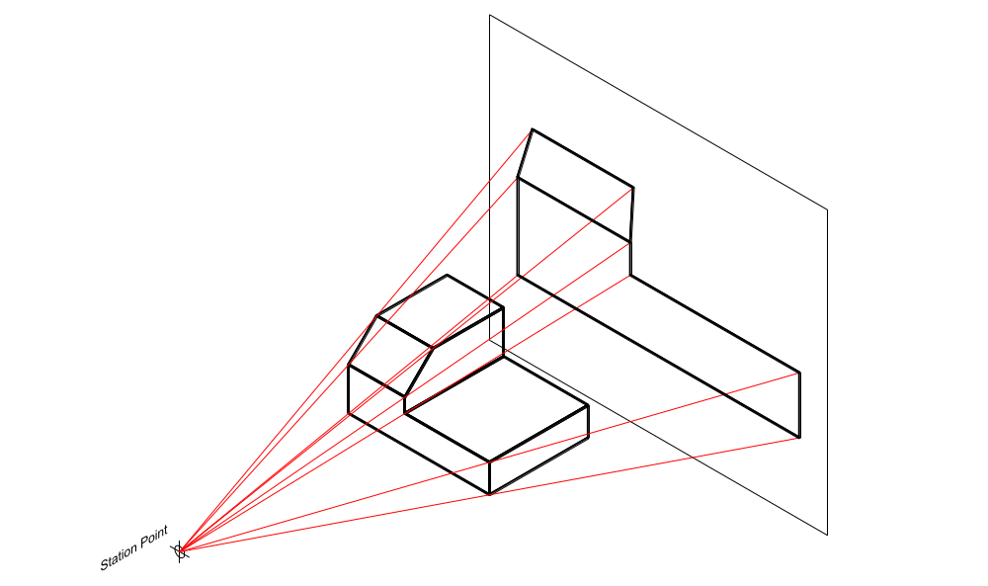
Perspective Projection observing the object directly
(Object between observer and Plane)

Slide 8
SHAPE REPRESENTATION METHODS
Two fundamental methods of shape representation are used:
    Orthographic Views
    These consists of a set of two or more separate views of an object taken from different directions, generally at right angles to each other and arranged relative to each other in a definite way. Each of the views shows the shape of the object for a particular view direction and collectively the views describe the object completely. Orthographic projection only is used.
    Pictorial Views
    In this method, the object is oriented either behind or in front of a single plane and projected upon it. Either orthographic, oblique, or perspective projection is used.

Slide 9
PRINCIPAL PLANES OF PROJECTION
    Vertical Plane
    Used for the projection of Front View.
    Horizontal Plane
    Used for the projection of Top View.
The horizontal plane and the vertical plane intersect at right angle and create a line of intersection known as the reference line. This intersection also creates four quadrants.

Slide 10
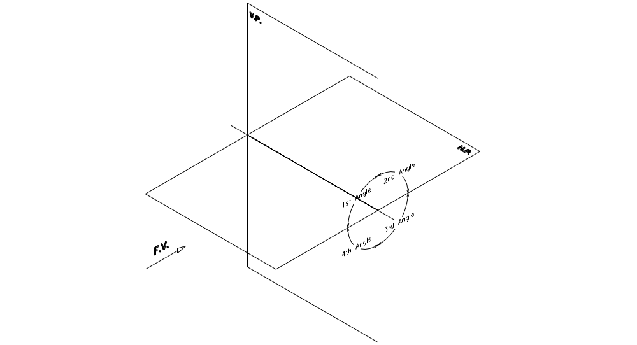
PRINCIPAL PLANES OF PROJECTION

Slide 11
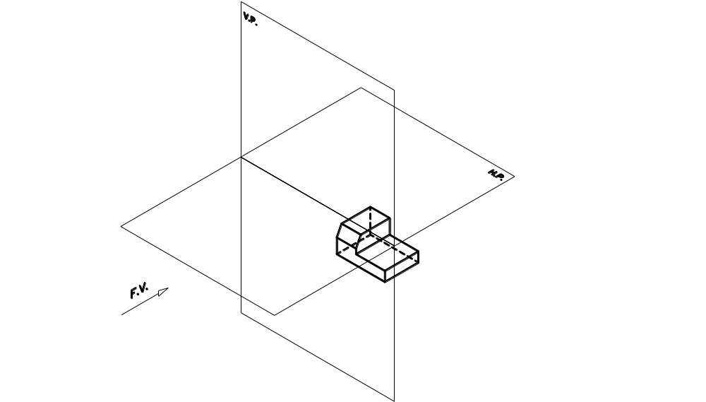
THIRD ANGLE PROJECTION METHOD
Plane of projection is always between the object and observer.

Slide 12
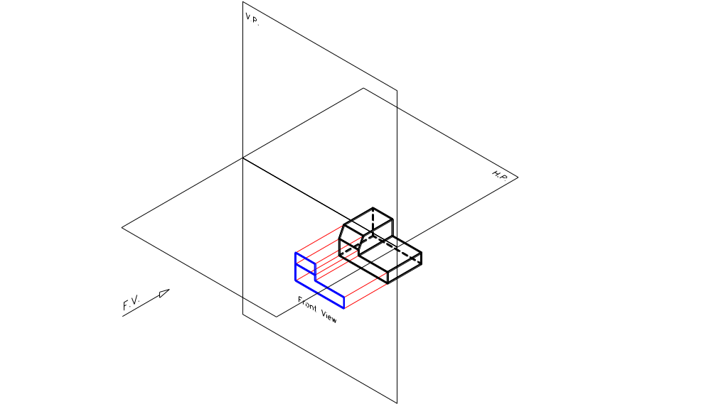
THIRD ANGLE PROJECTION METHOD
Projection of Front View

Slide 13
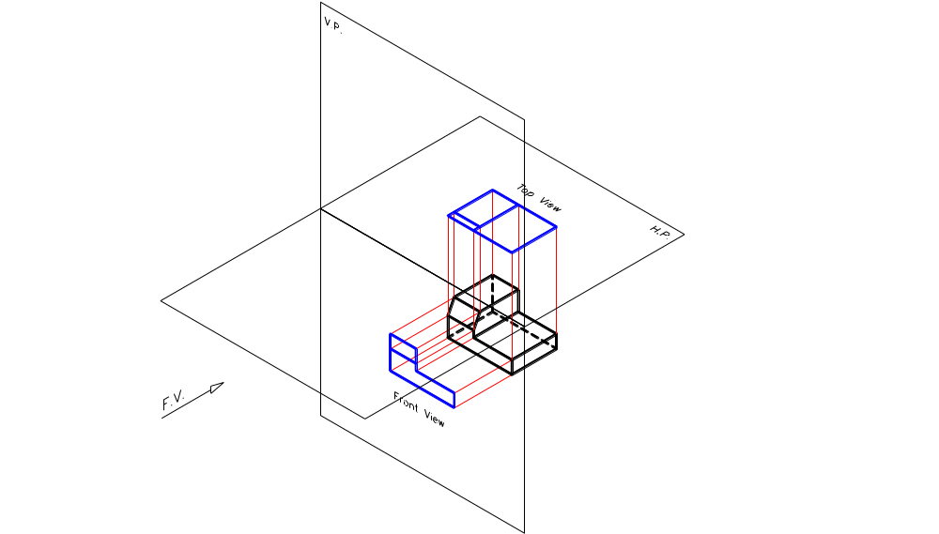
THIRD ANGLE PROJECTION METHOD
Projection of Top View

Slide 14
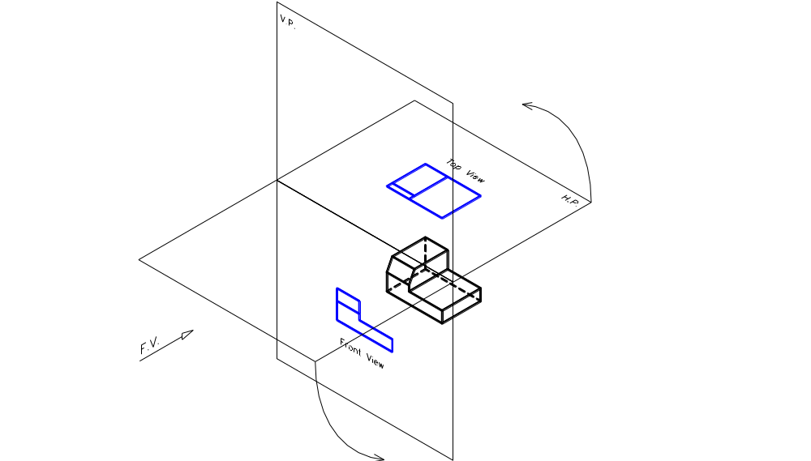
THIRD ANGLE PROJECTION METHOD
Bringing Front View and Top View in One Plane
(Always open 1st Angle by rotating the H.P. about the V.P.)

Slide 15
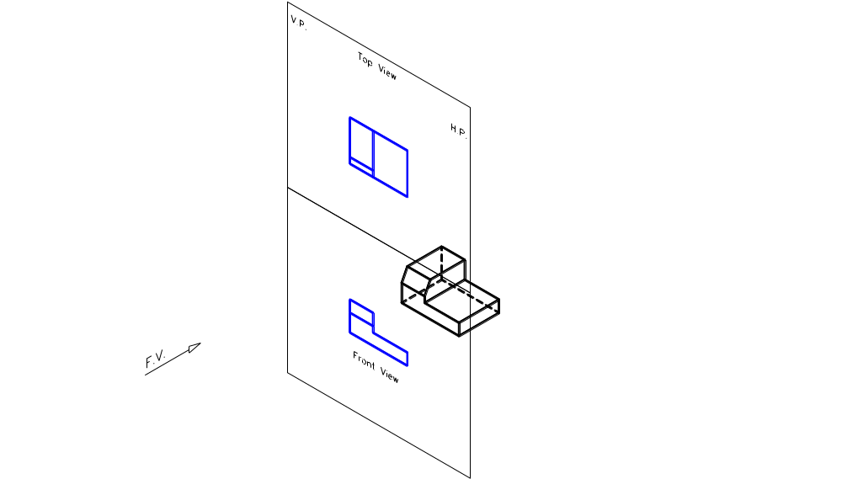
THIRD ANGLE PROJECTION METHOD
Bringing Front View and Top View in One Plane
(Always open 1st Angle by rotating the H.P. about the V.P.)

Slide 16
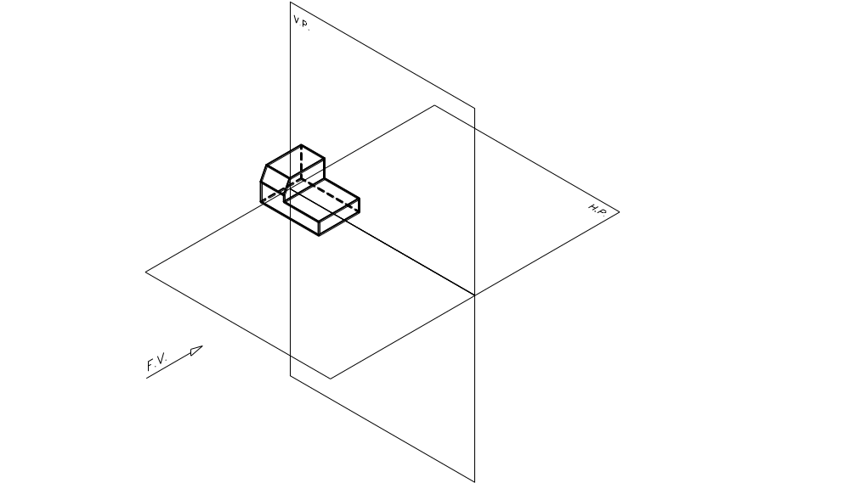
FIRST ANGLE PROJECTION METHOD
Object is always between the plane of projection and the observer.

Slide 17
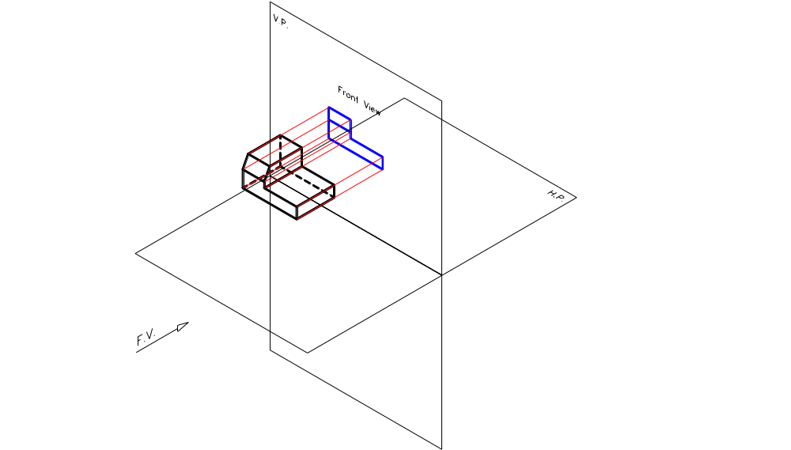
FIRST ANGLE PROJECTION METHOD
Projection of Front View

Slide 18
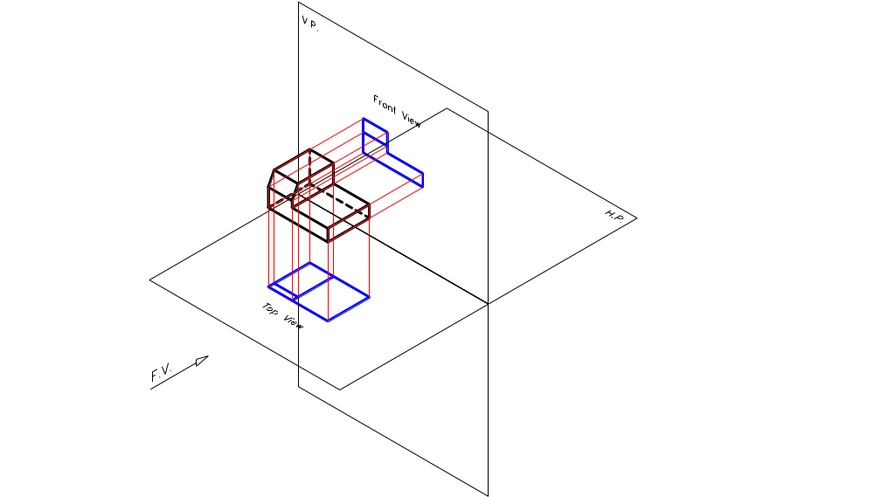
FIRST ANGLE PROJECTION METHOD
Projection of Top View

Slide 19
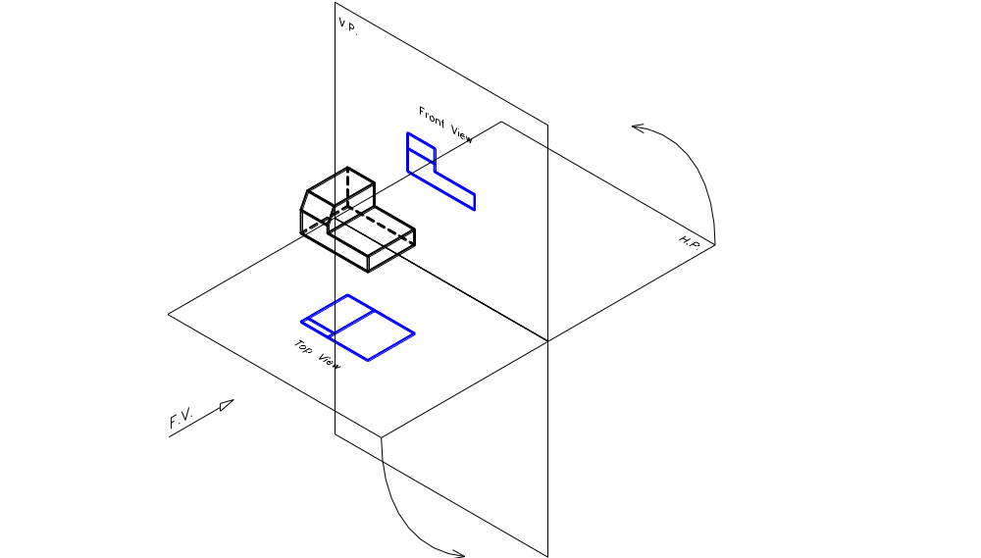
FIRST ANGLE PROJECTION METHOD
Bringing Front View and Top View in One Plane
(Always open 1st Angle by rotating the H.P. about the V.P.)

Slide 20
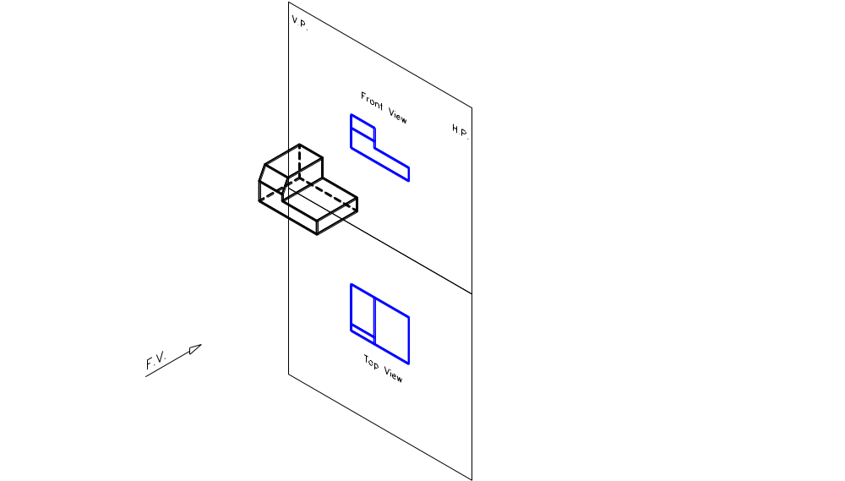
FIRST ANGLE PROJECTION METHOD
Bringing Front View and Top View in One Plane
(Always open 1st Angle by rotating the H.P. about the V.P.)

Slide 21
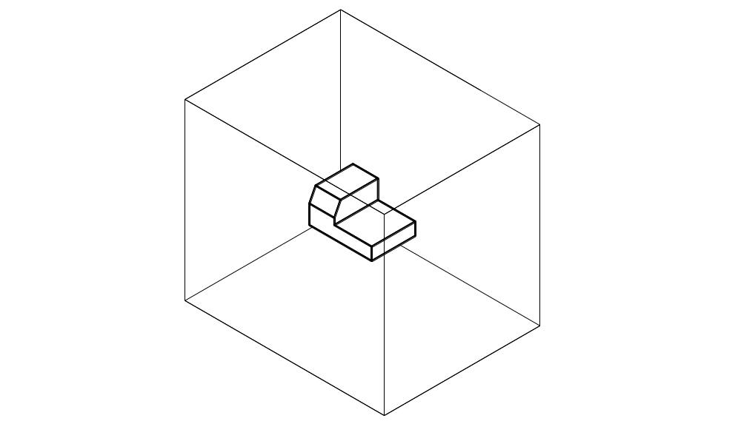
THE SIX PRINCIPAL VIEWS
The object can be entirely surrounded by a set of six transparent planes, each at right angles to the four adjacent to it.

Slide 22
The object is in a transparent box.
In the First Angle Projection method, the observer stands inside the box, thus keeping the object between him and the plane of projection.
In the Third Angle Projection method, the observer stands outside the box, keeping the plane of projection always between him and the object.

Slide 23
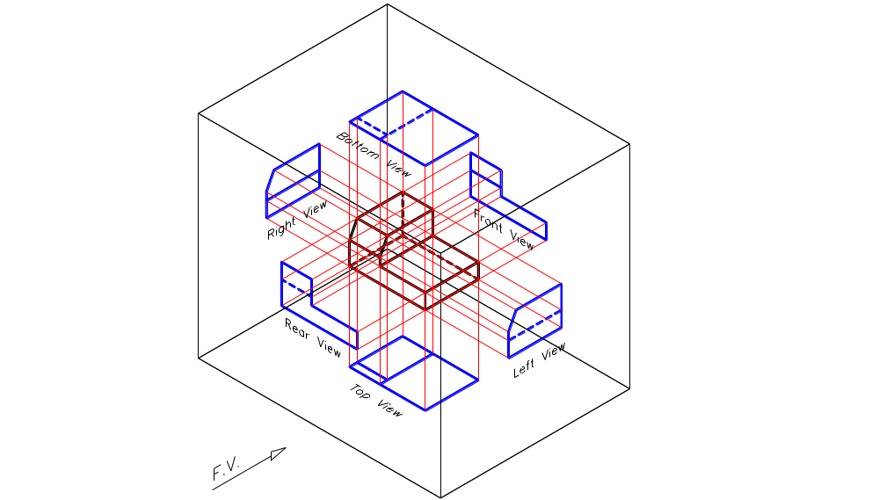
In the First Angle Projection method, the views are projected to the other side of the object.

Slide 24
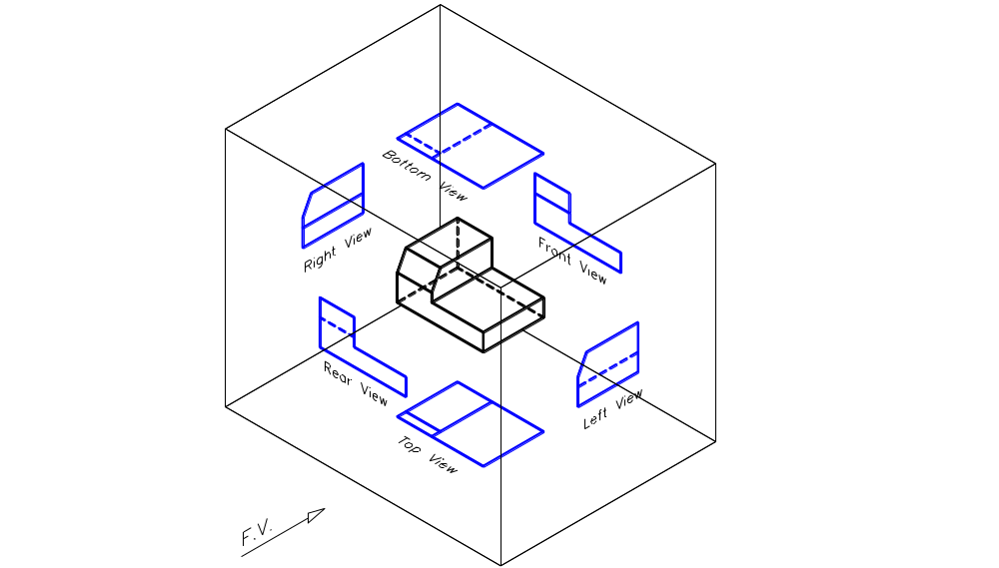
Placement of Six Views in the First Angle Projection Method
(Observe the object from inside the box)

Slide 25
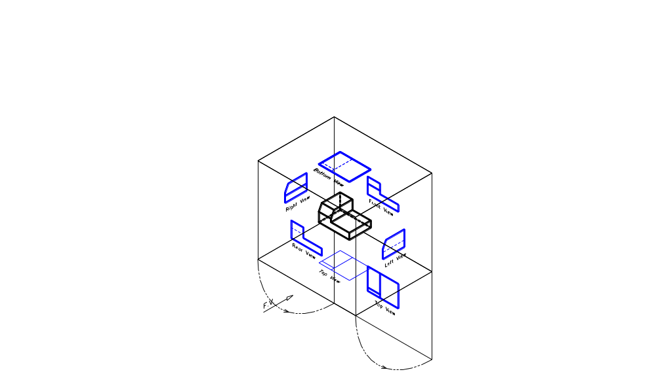
Opening the Transparent Box to bring the six views in one plane (1st Angle)

Slide 26
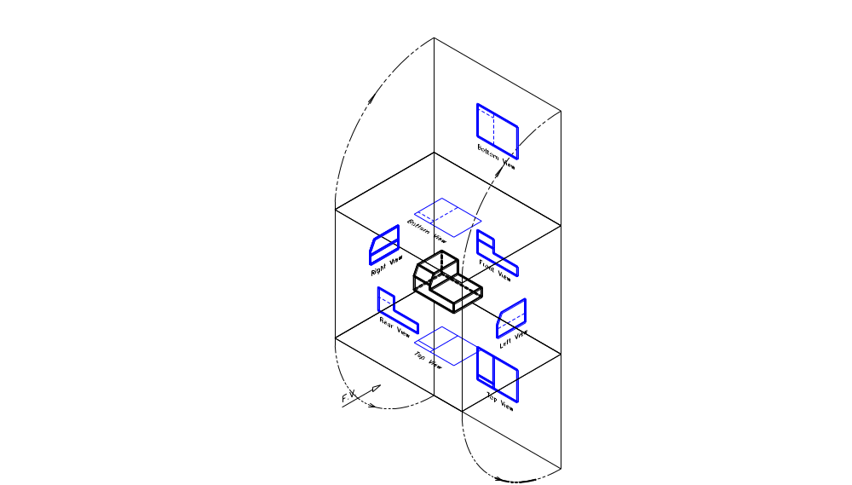
Opening the Transparent Box to bring the six views in one plane (1st Angle)

Slide 27
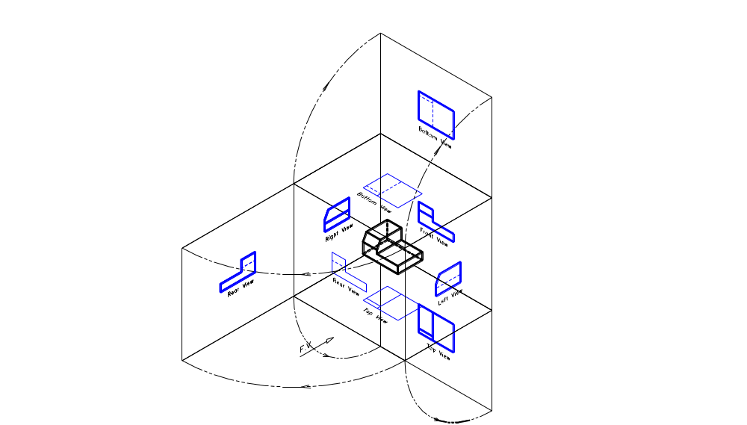
Opening the Transparent Box to bring the six views in one plane (1st Angle)

Slide 28
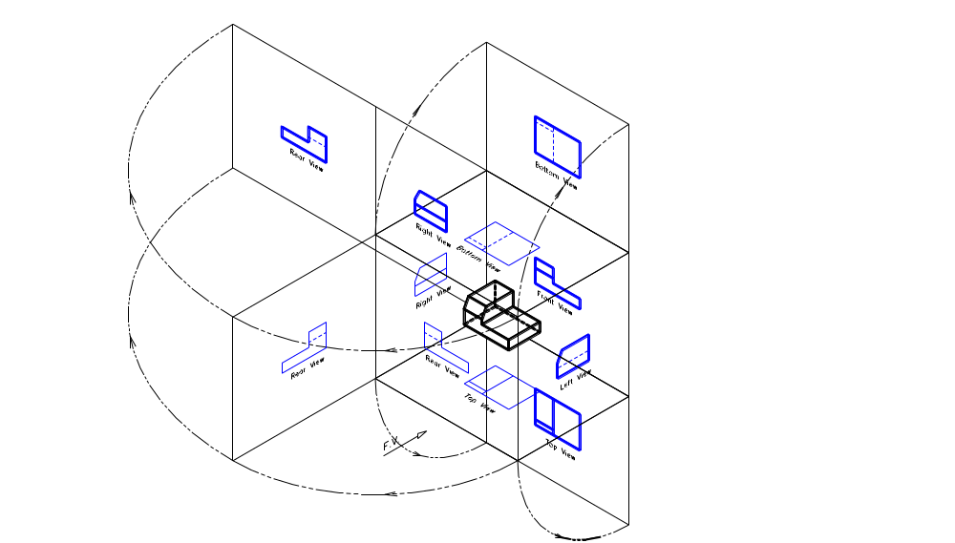
Opening the Transparent Box to bring the six views in one plane (1st Angle)

Slide 29
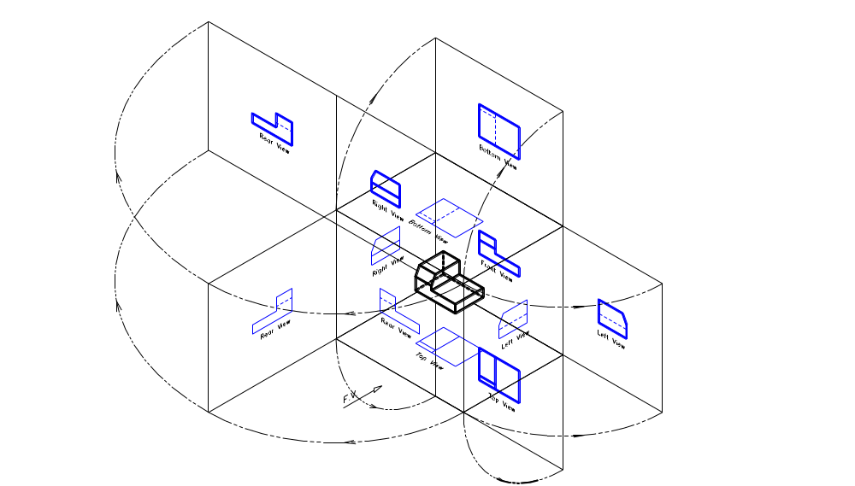
Opening the Transparent Box to bring the six views in one plane (1st Angle)

Slide 30
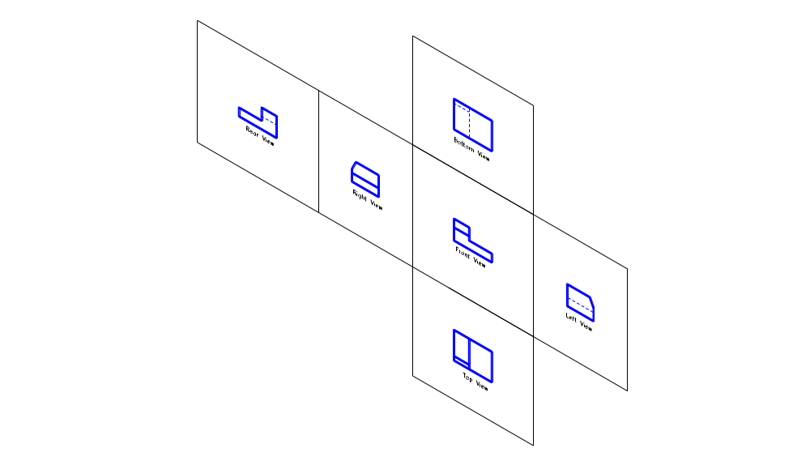
The six views in one plane (1st Angle)

Slide 31
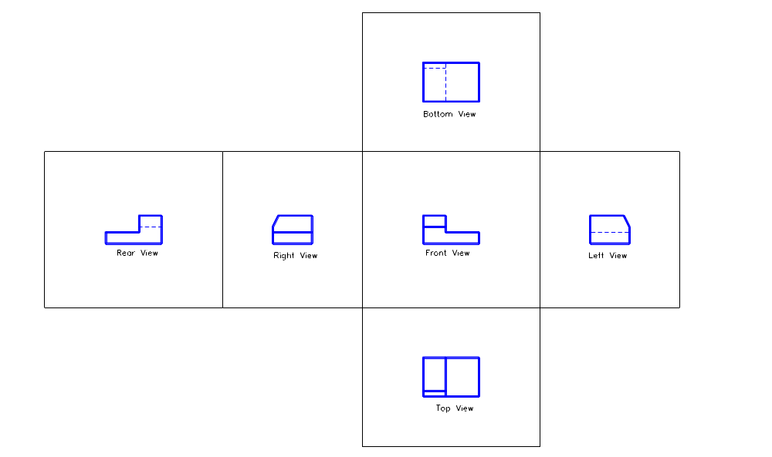
The six views in one plane (1st Angle)

Slide 32
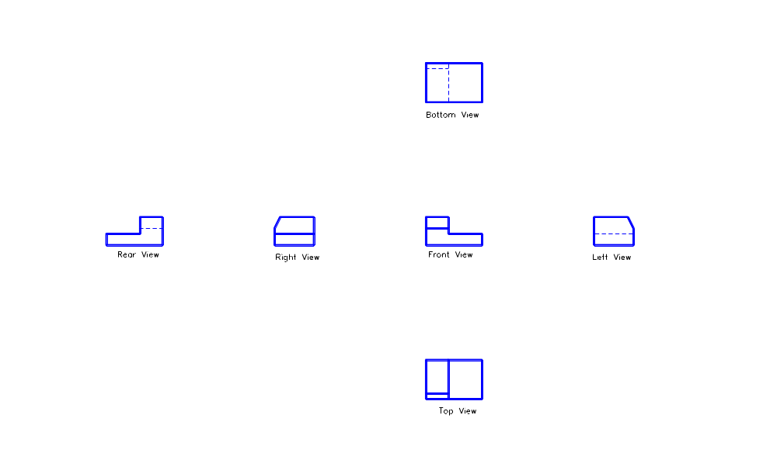
The six views in one plane (1st Angle)

Slide 33
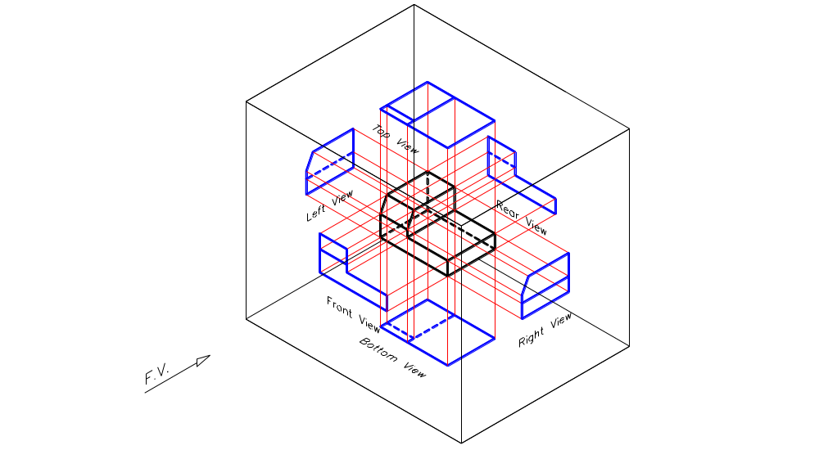
In the Third Angle Projection method, the views are projected to the same side of the object.

Slide 34
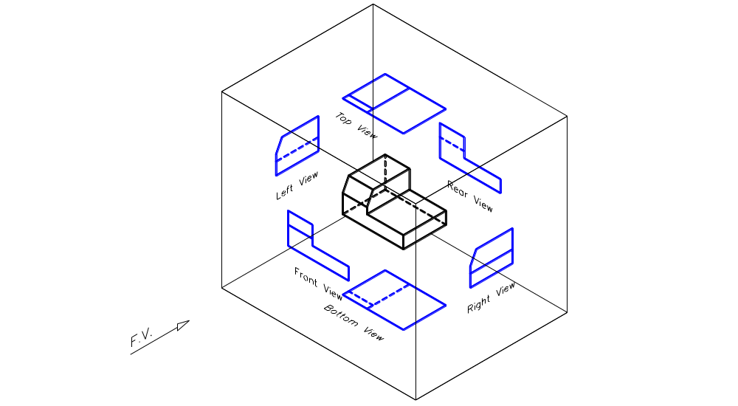
Placement of Six Views in the Third Angle Projection Method
(Observe the object from outside the box)

Slide 35
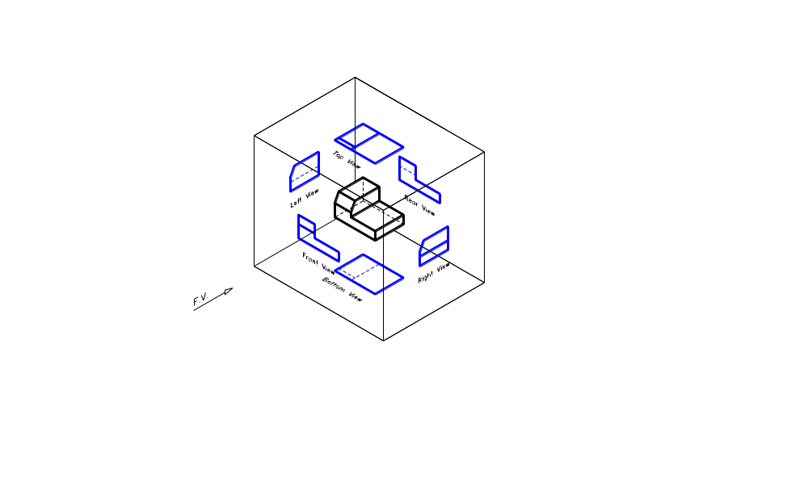
Opening the Transparent Box to bring the six views in one plane (3rd Angle)

Slide 36
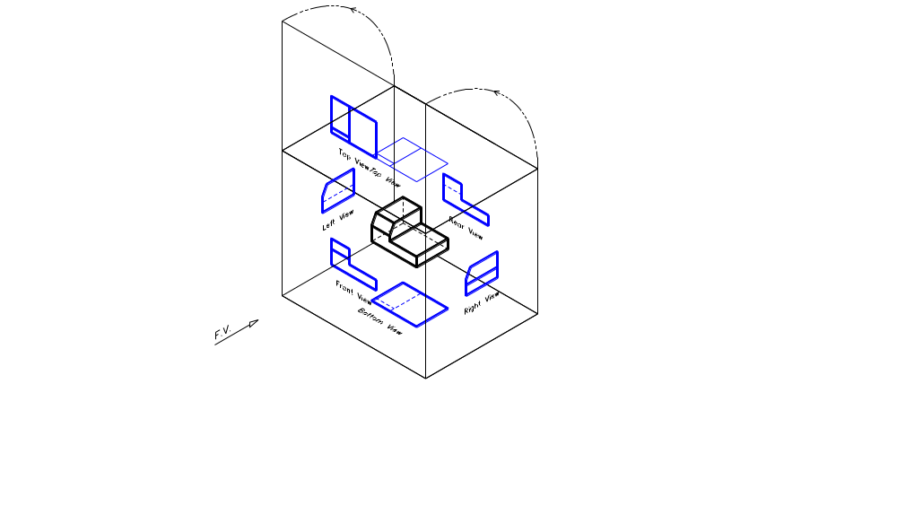
Opening the Transparent Box to bring the six views in one plane (3rd Angle)

Slide 37
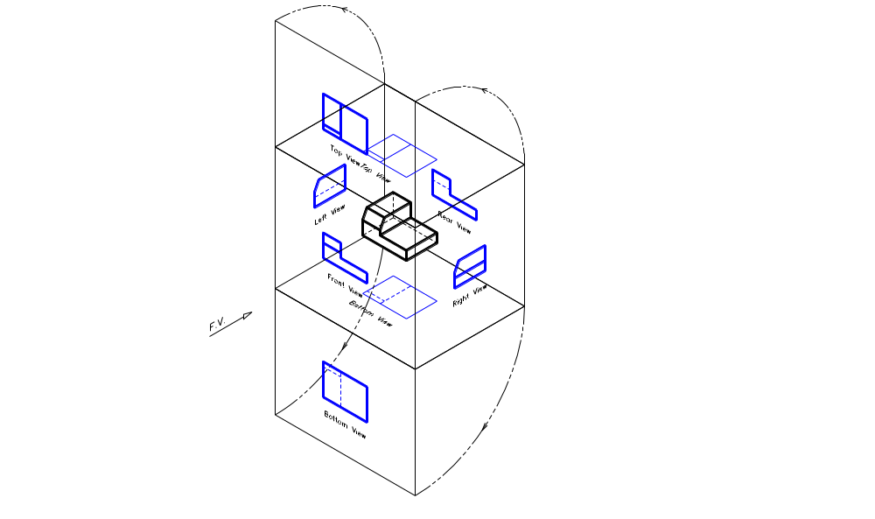
Opening the Transparent Box to bring the six views in one plane (3rd Angle)

Slide 38
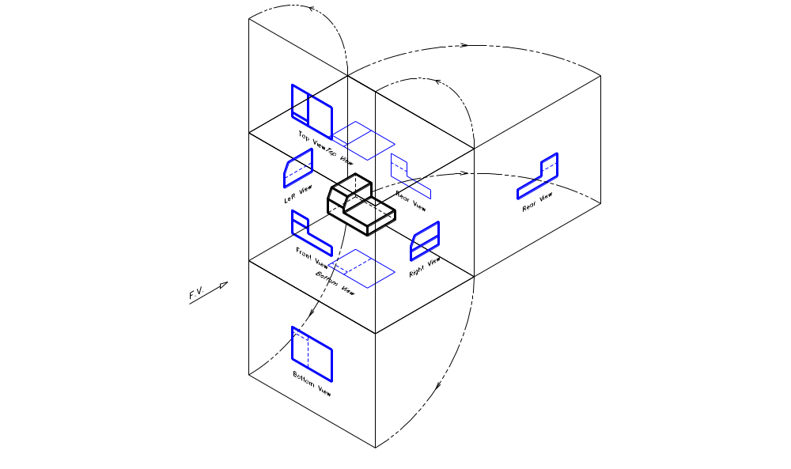
Opening the Transparent Box to bring the six views in one plane (3rd Angle)

Slide 39
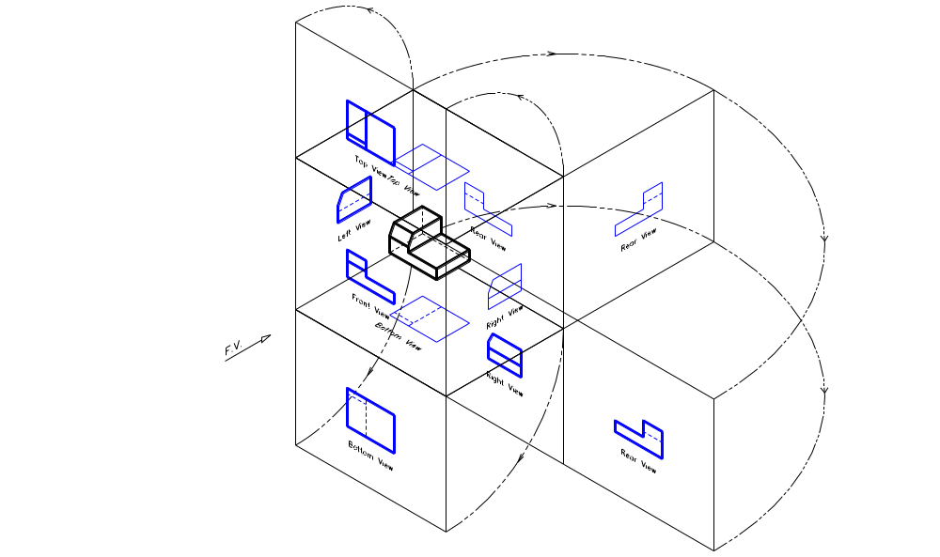
Opening the Transparent Box to bring the six views in one plane (3rd Angle)

Slide 40
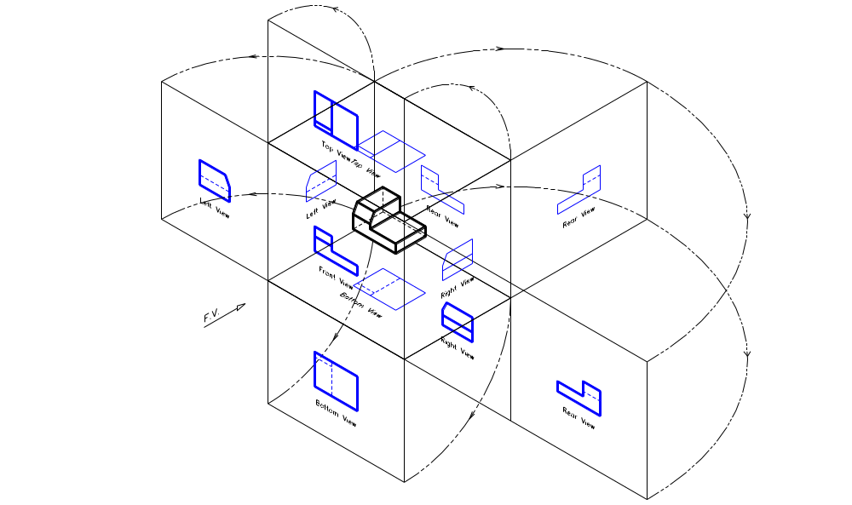
Opening the Transparent Box to bring the six views in one plane (3rd Angle)

Slide 41
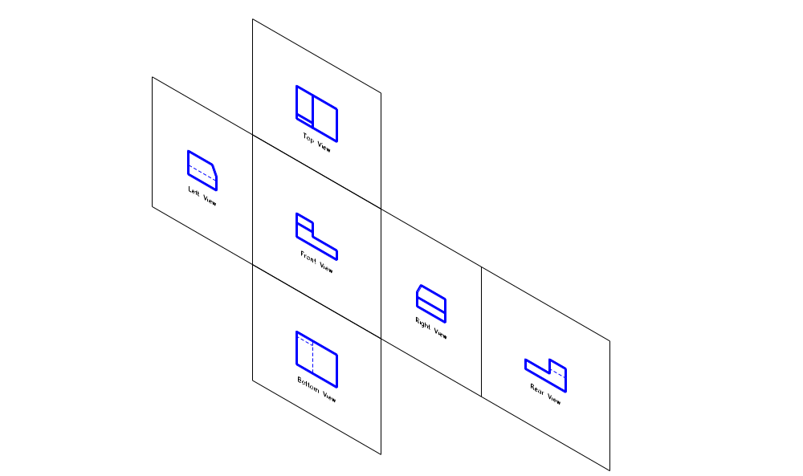
The Six Views in One Plane (3rd Angle)

Slide 42
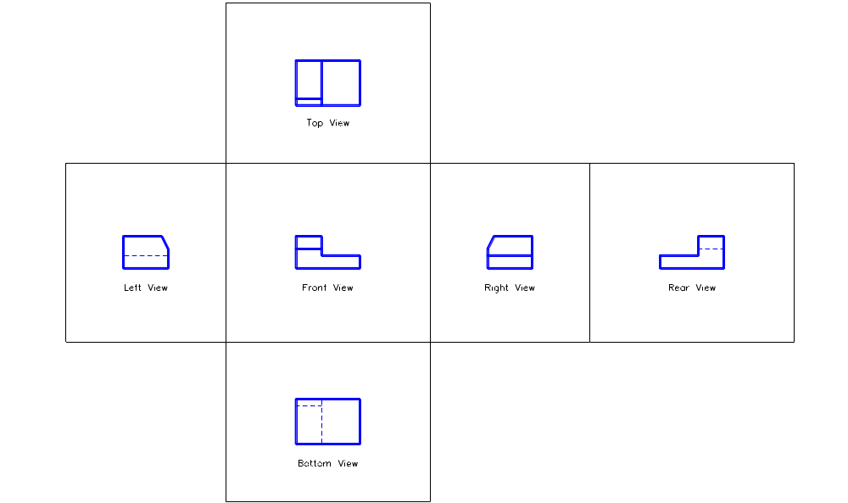
The Six Views in One Plane (3rd Angle)

Slide 43
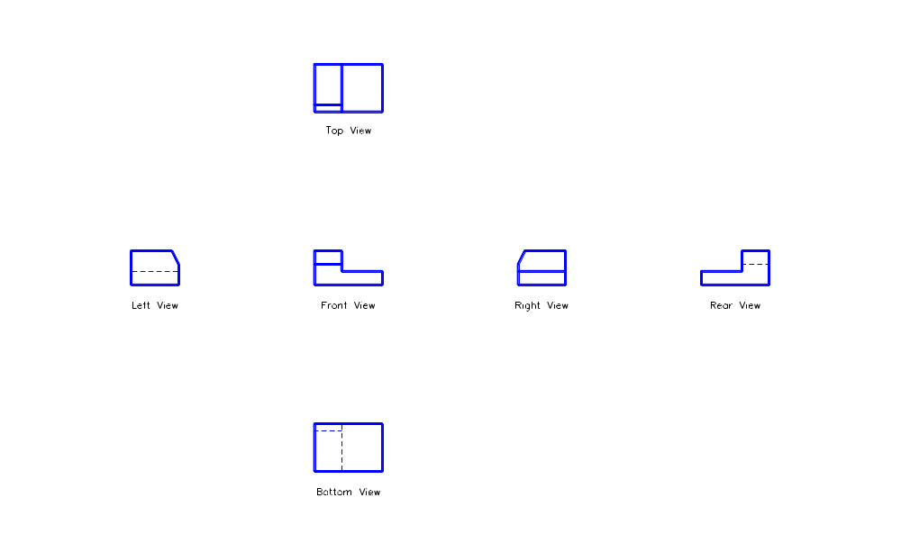
The Six Views in One Plane (3rd Angle)

Slide 44
USING ORTHOGRAPHIC PROJECTIONS
OBJECT ORIENTATION
An object can be drawn in several possible positions. In general the simplest position shall be used. The object shall be positioned in such a way so that the principal faces shall lie perpendicular to the direction of vision.
SELECTION OF VIEWS
It is important to choose the combination of views that will describe the shape of the object in the best and most economical way. Often only two views are necessary. However, in some case three or more views might be required to fully describe the object. Unnecessary views shall be avoided.
VIEW SPACING
View spacing is necessary so that the drawing will be balanced within the space provided.

Slide 45
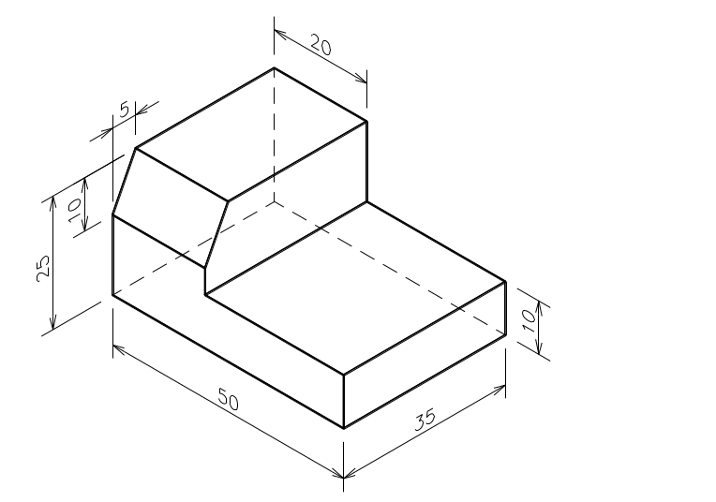
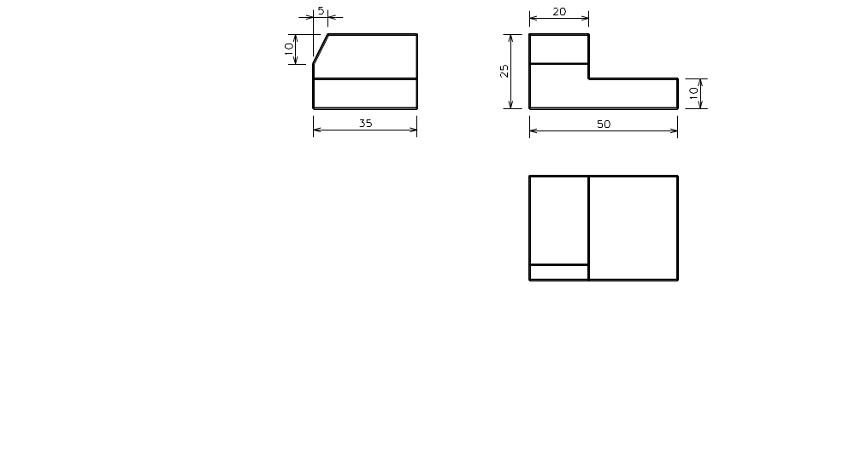

Slide 46


Slide 47


Slide 48


Slide 49
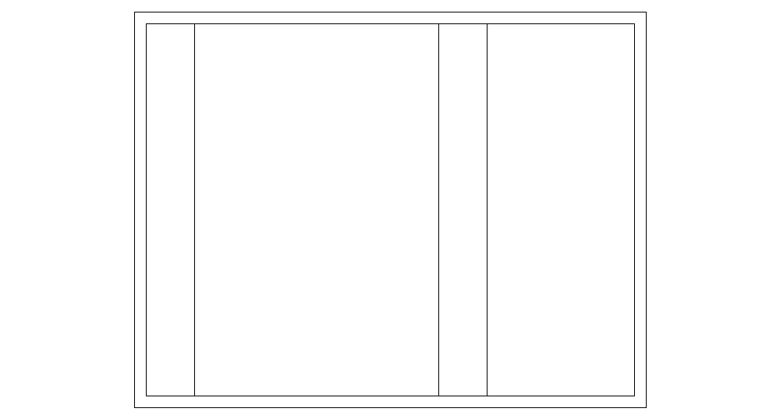

Slide 50
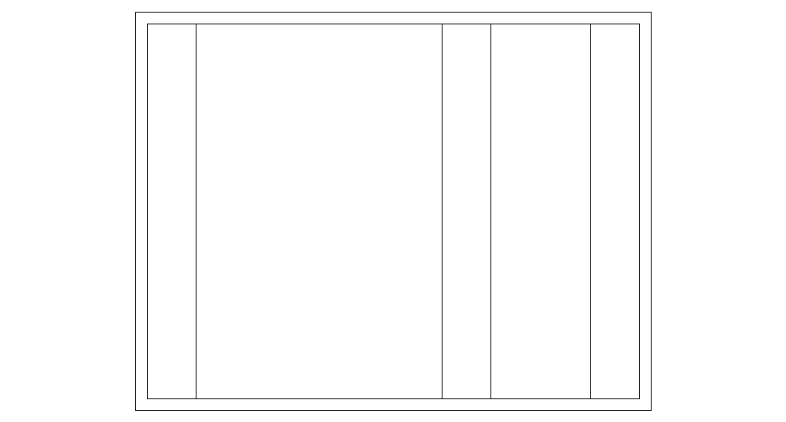

Slide 51
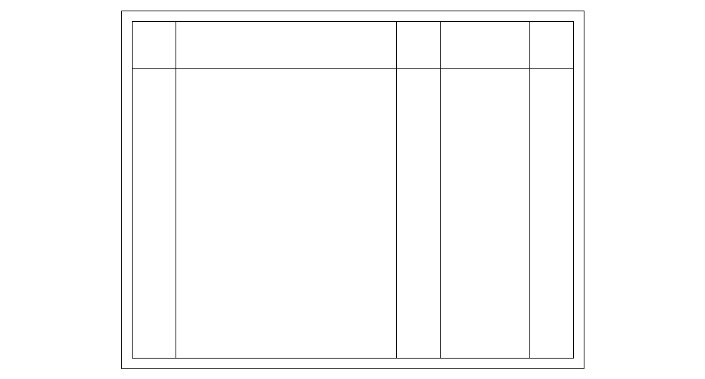

Slide 52
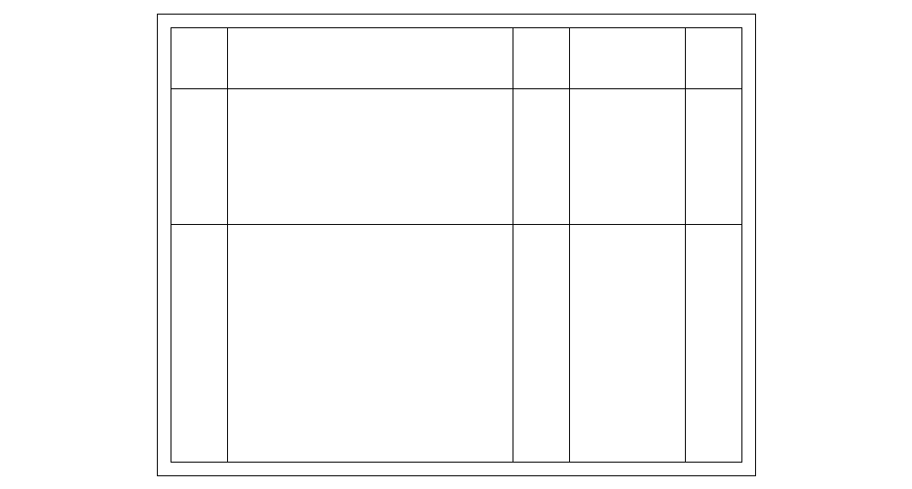

Slide 53
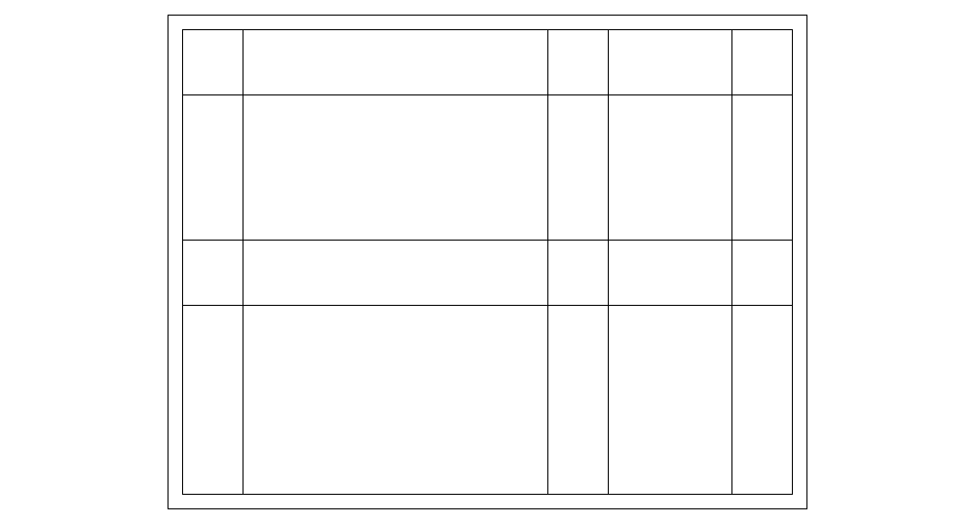

Slide 54
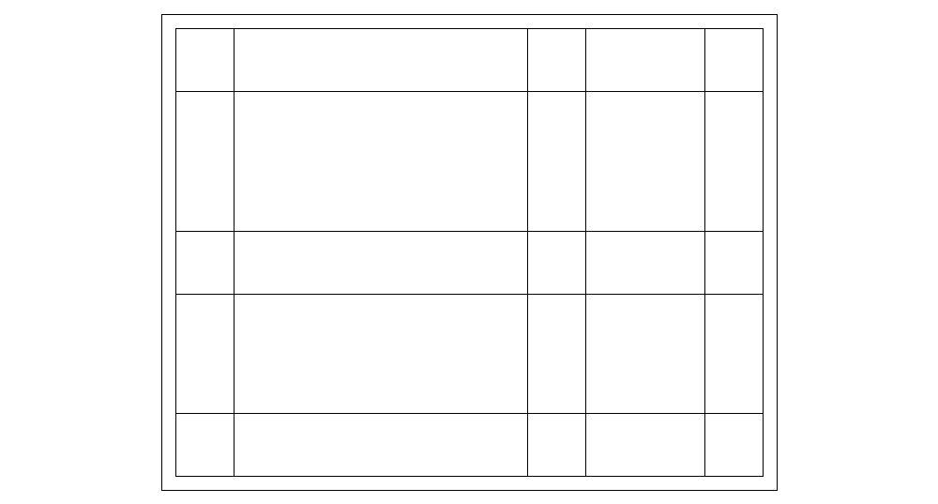

Slide 55
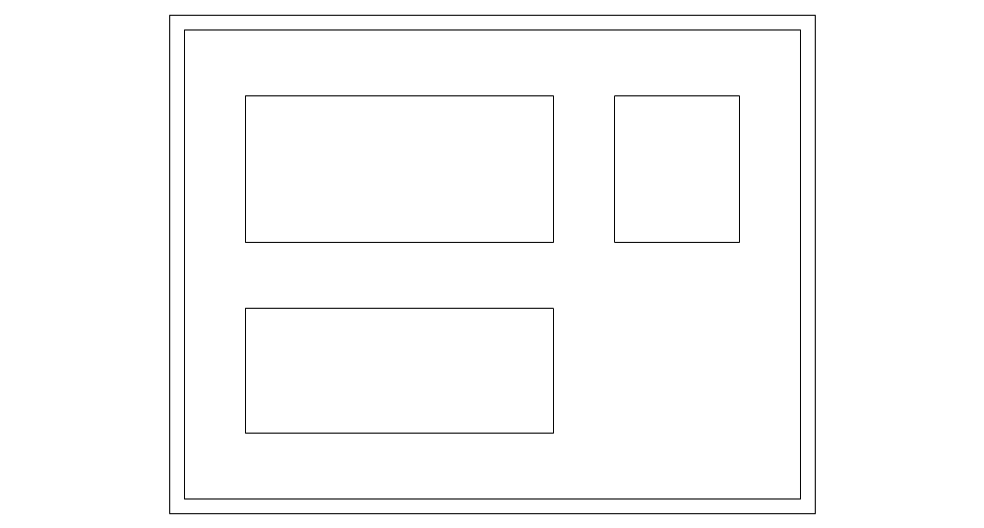

Slide 56
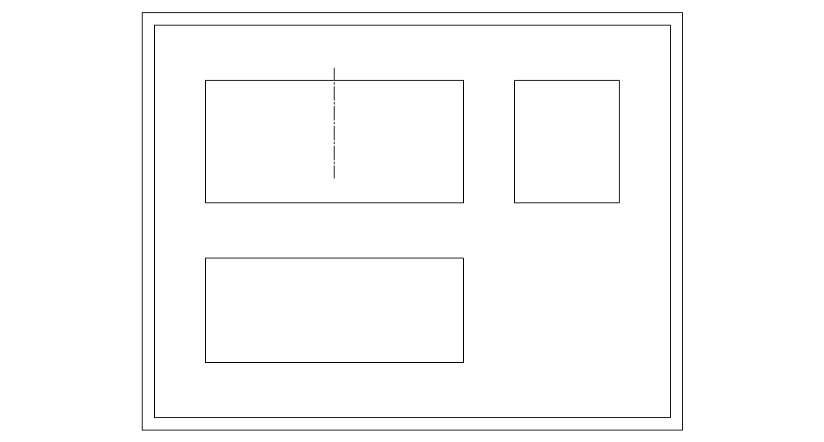

Slide 57
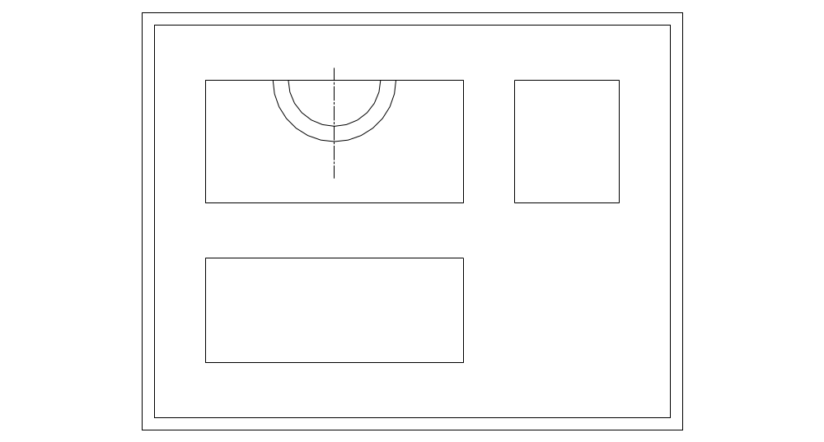

Slide 58


Slide 59


Slide 60


Slide 61


Slide 62


Slide 63


Slide 64


Slide 65


Slide 66


Slide 67


Slide 68


Slide 69


Slide 70


Slide 71


Slide 72


Slide 73


Slide 74


Slide 75


Slide 76


Slide 77


Slide 78


Slide 79


Slide 80


Slide 81


Slide 82


Slide 83


Slide 84


Slide 85


Slide 86


Slide 87


Slide 88


Slide 89


Slide 90


Slide 91


Slide 92


Slide 94


Slide 95


